Slide 1
Identifying abnormal sea states and
grouping similar sea states by clustering
~ Application to hazard maps ~
Ren Tsuchida Tai

Slide 2
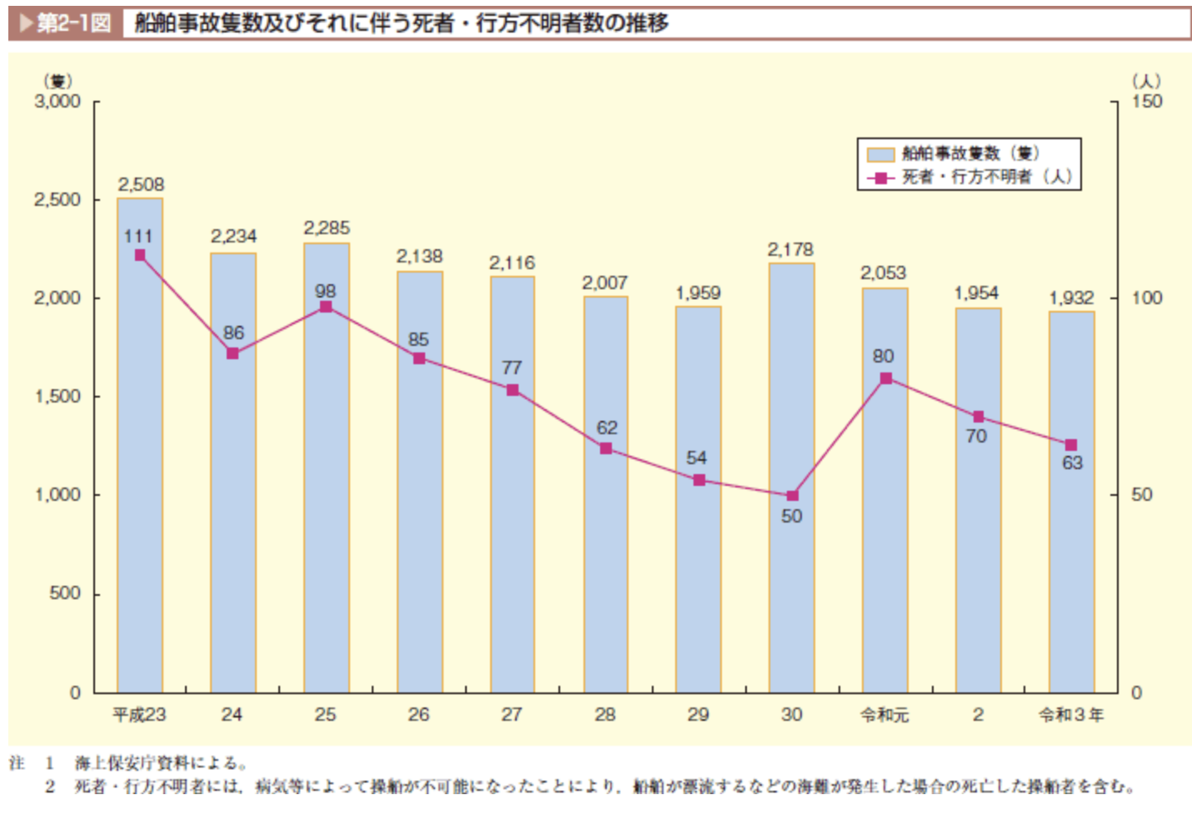
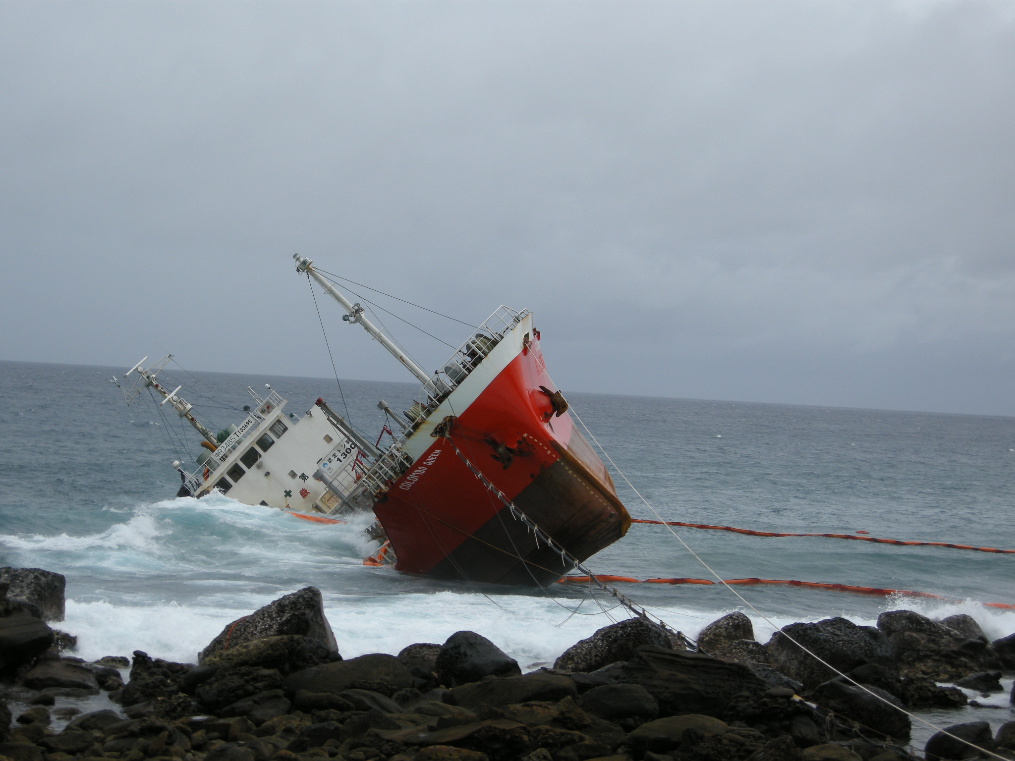
Background
A large number of maritime accidents occur at sea each year, many of which are related to weather and sea conditions
Maritime accident[1]
Number of maritime accidents around Japan[2]

Slide 3
Purpose
Challenges
・Quantitative prediction of accident risk remains inadequate.
・Real-time utilization of weather data is limited.
Objective
・To develop a machine learning model that uses wave and wind data to predict maritime accident risks.

Slide 4

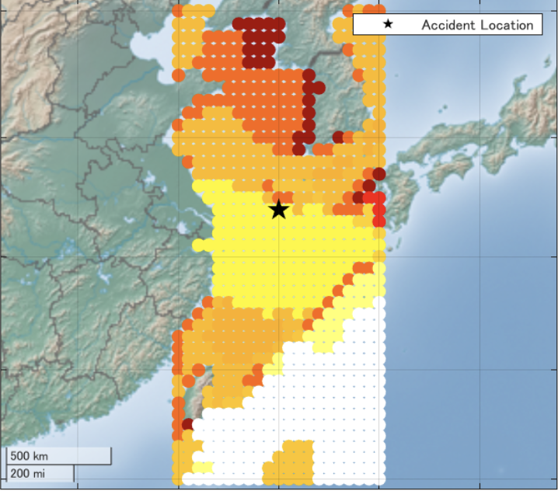


Analysis overview
We used wind, wave, and accident data to create an accident risk prediction model and a hazard map to visualize accident risk in the sea area.
Wave/Wind
data
(ECMWF ERA5 reanalysis data[3])
Accident
data
(IMO GISIS[4])
training data
ML model
hazard map
test data

Slide 5
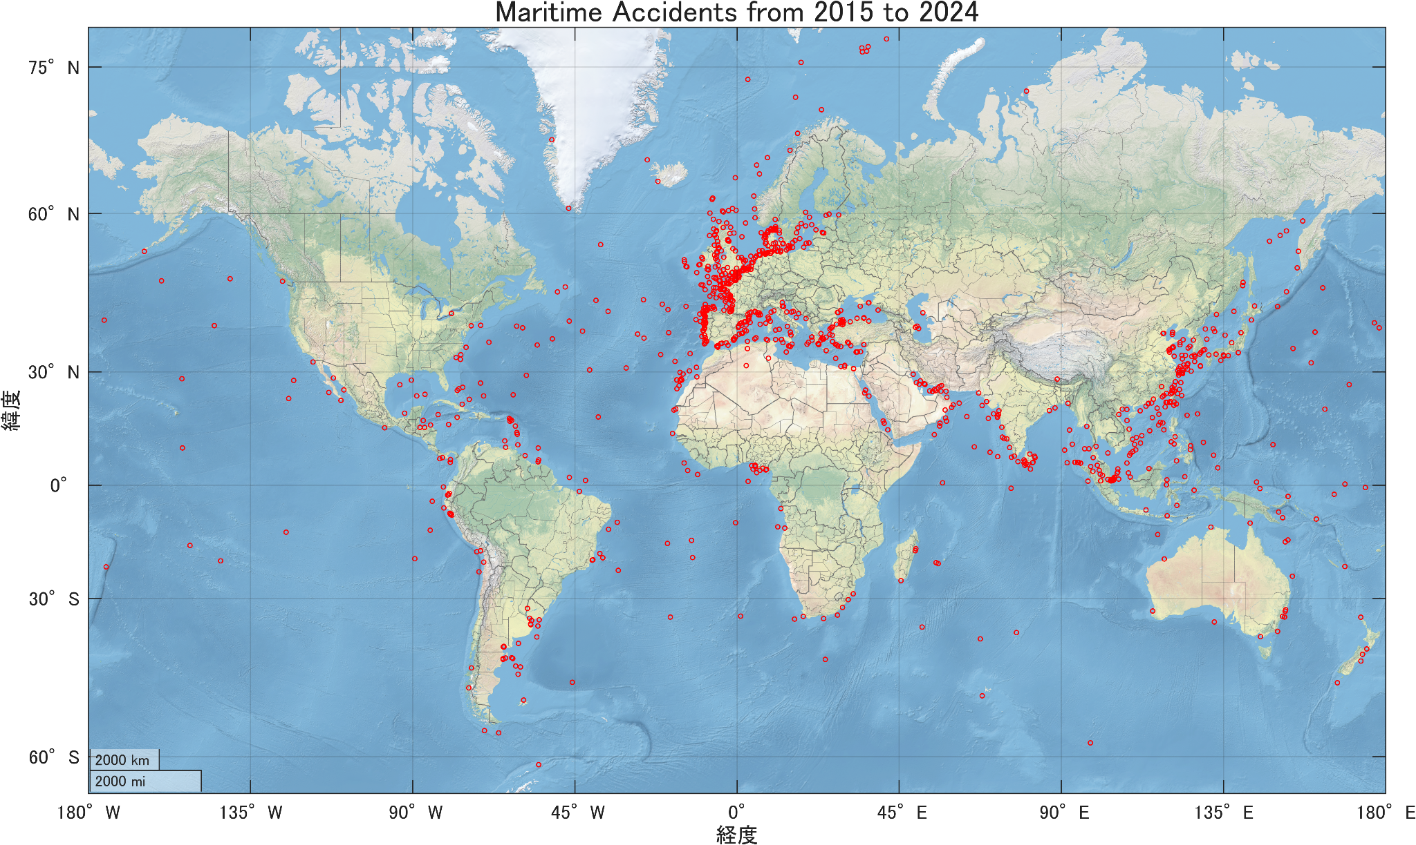
Accident Record

Slide 6
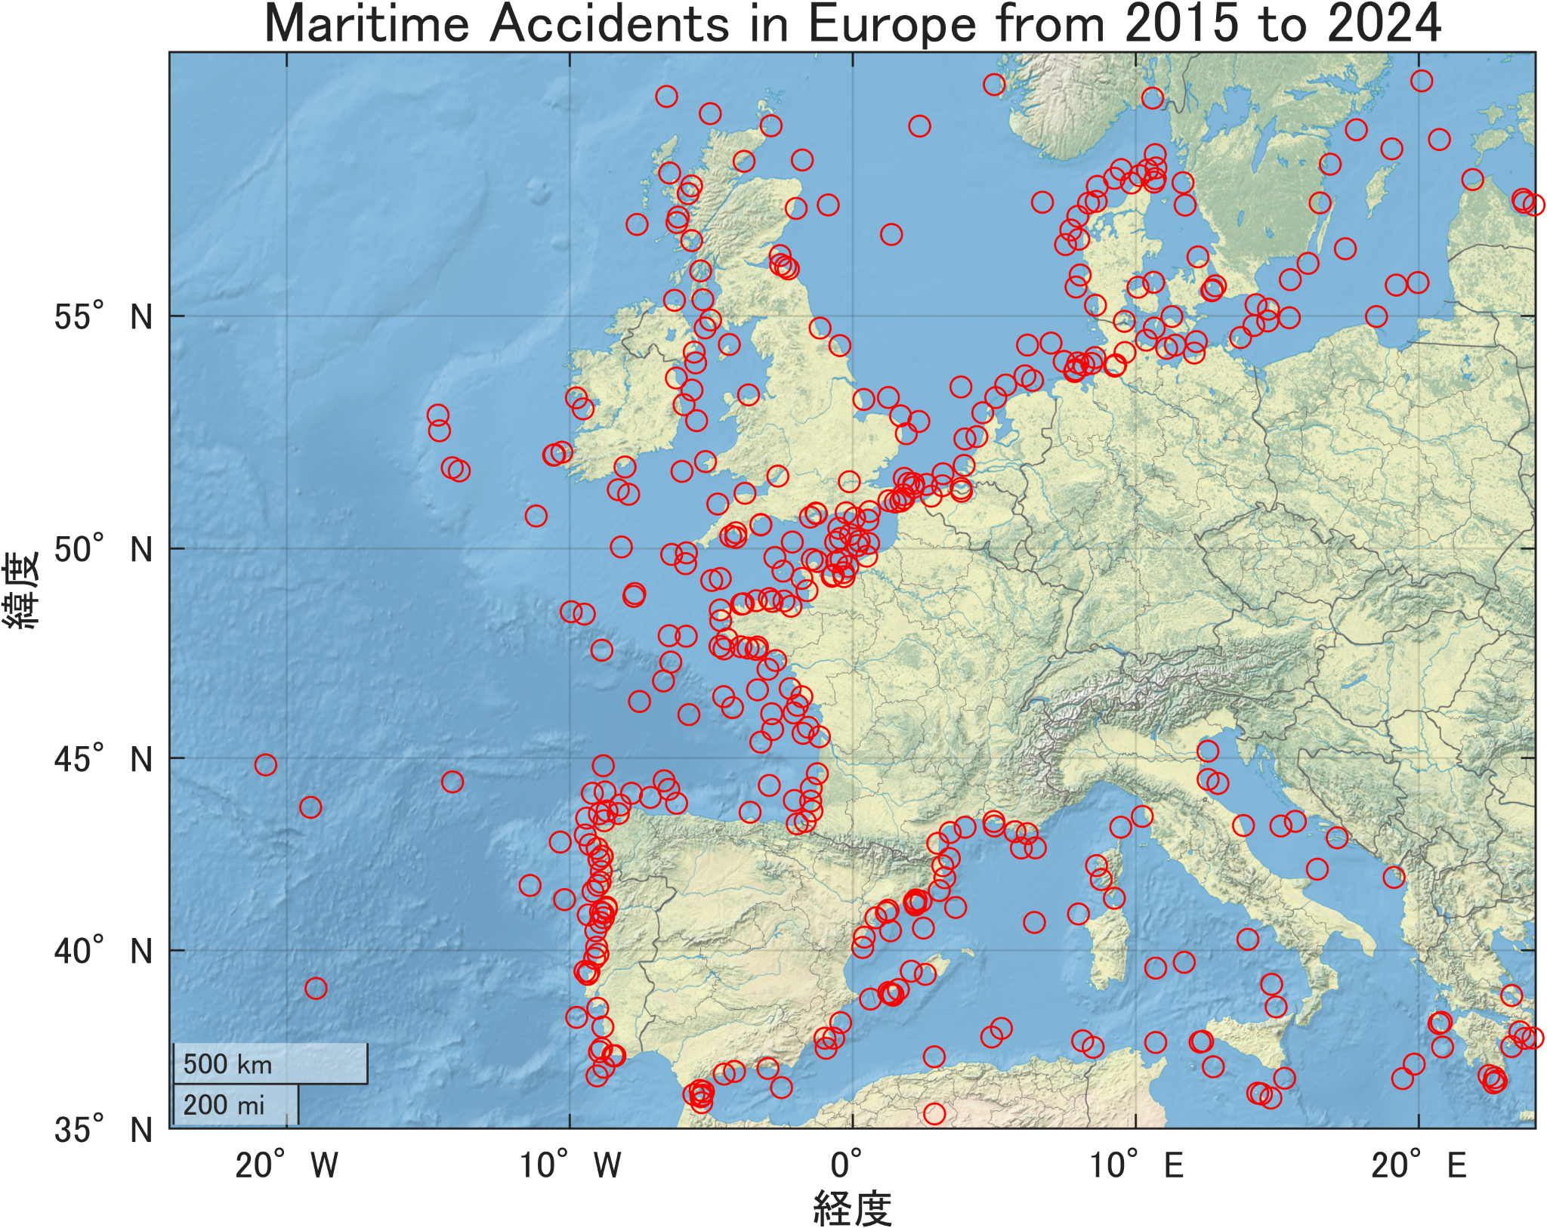
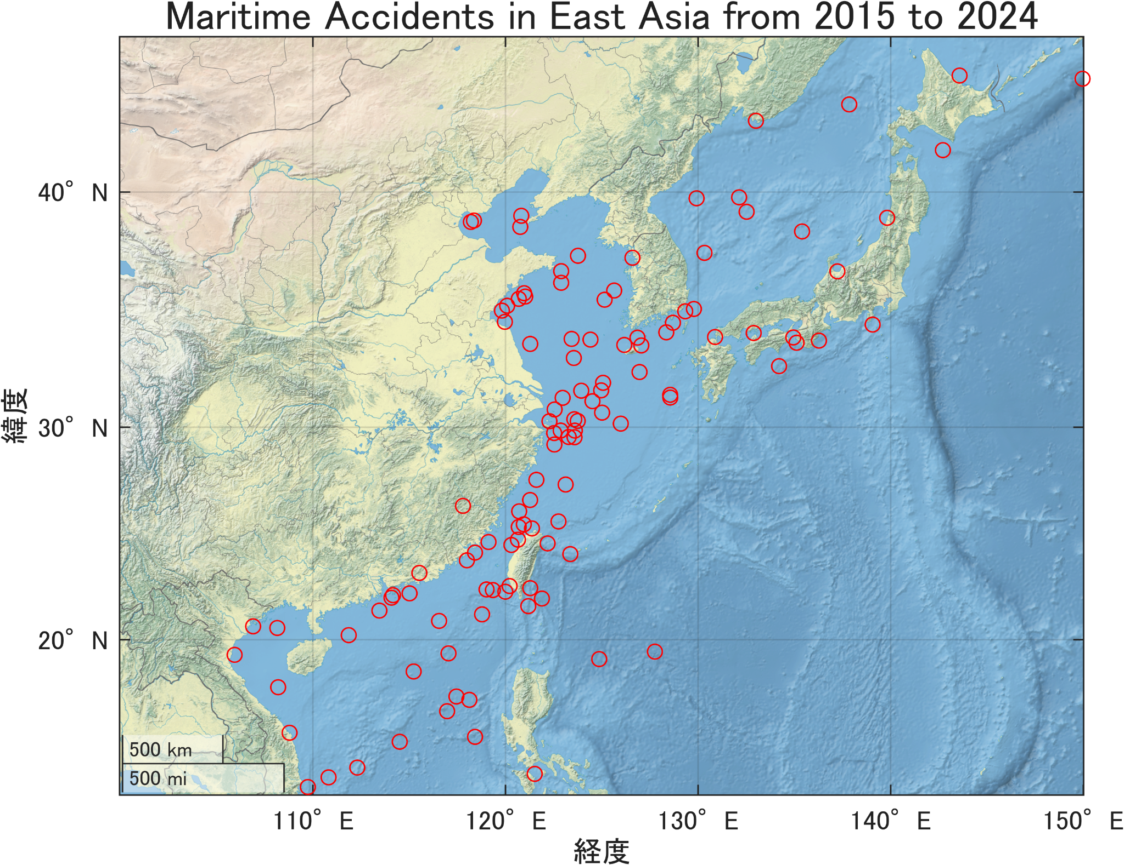
Accident Record
There are many accidents in Europe and East Asia. We analyze a part of the East China Sea, close to Japan, where accidents are concentrated.
Analysis
Target Area

Slide 7
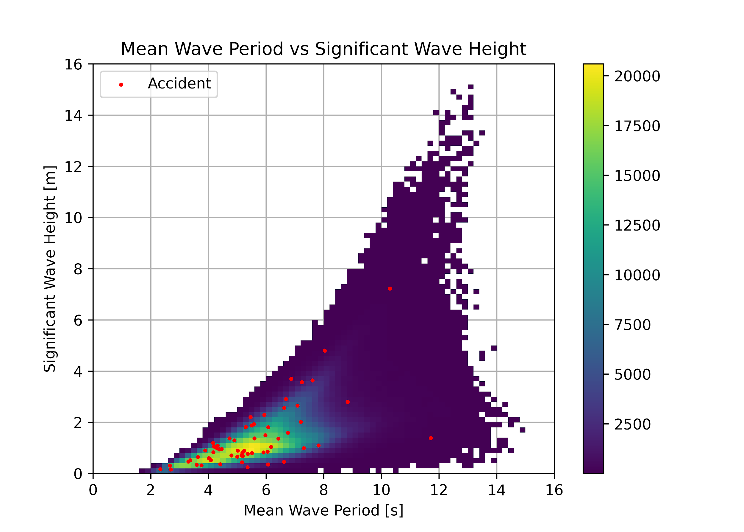
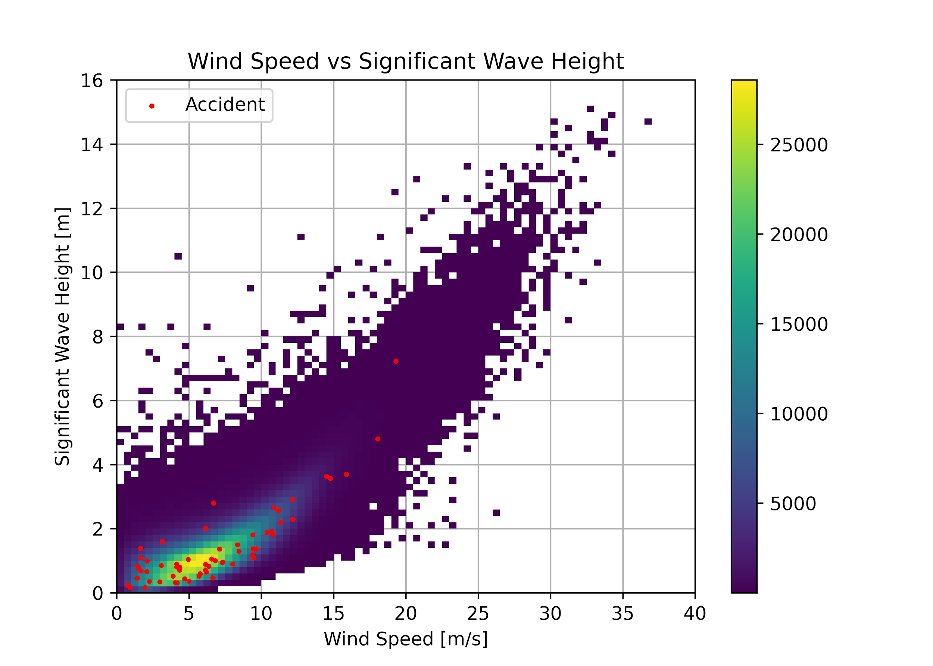
Data Analysis
Accidents do NOT often occur in extreme cases where wave heights, wave periods, or wind speeds are high.
① When sea conditions are extremely rough, ships do not leave port.
② The probability of extreme sea conditions occurring is low.

Slide 8
Steps
2015-2023
Clustering
Identifying abnormal sea states
Grouping of similar sea states
For abnormal sea states, label them as "potentially dangerous."
For general sea states, calculate the likelihood of accident for each cluster and label them.
For the target sea area on the date and time of the accident, identify the closest cluster based on the center of gravity of each cluster.
Visualize on a map the likelihood of accidents occurring for each cluster.
2024

Slide 9
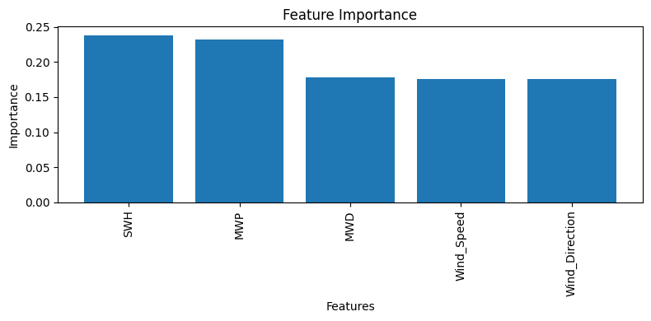
Clustering
Clustering Approaches
Features
Wave Features: MWP (Mean Wave Period), MWD(Mean Wave Direction), SWH(Significant Wave Height).
Wind Features: Wind Speed, Wind Direction.
MiniBatch K-Means:
Efficient for large datasets.
Used to determine the optimal number of clusters (‘k’) based on Davies-Bouldin Index (DBI).
K-Means:
Applied to the entire dataset for final clustering using the optimal ‘k’.
Feature Importance:
Random Forest Classifier used to identify the most significant features.
PCA:
PCA is used to reduce the dimensionality.

Slide 10
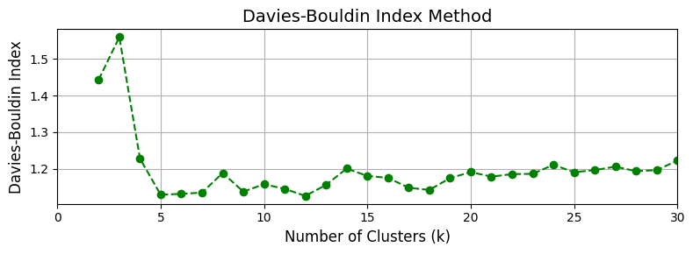
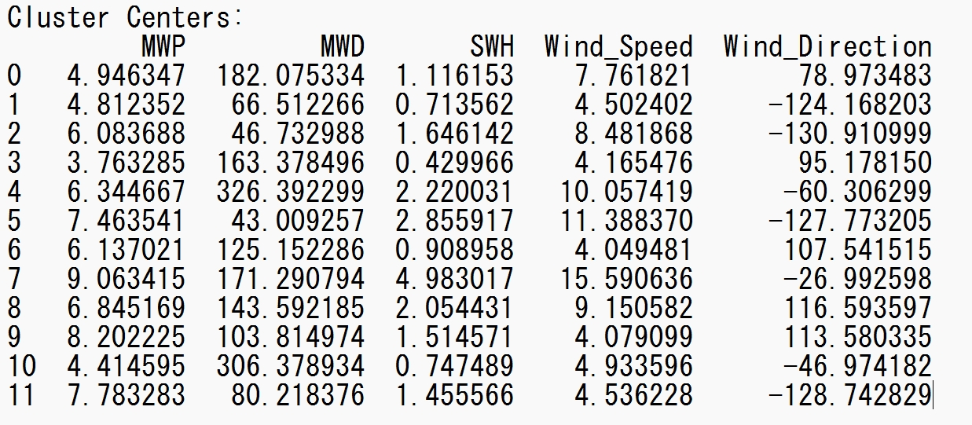
Clustering
Optimal Clustering (‘k’ Selection)
Cluster Differences
Davies-Bouldin Index (DBI): DBI measures clustering quality (lower is better).
Method: MiniBatch K-Means with batch size = 1024. Explored ‘k’ values from 2 to 30.
Results: Optimal ‘k’ = 12.
These characteristic centers represent the average environmental conditions for each category.
By looking at these central values, we are able to get a clearer picture of which environmental conditions are more relevant to accident risk.”

Slide 11
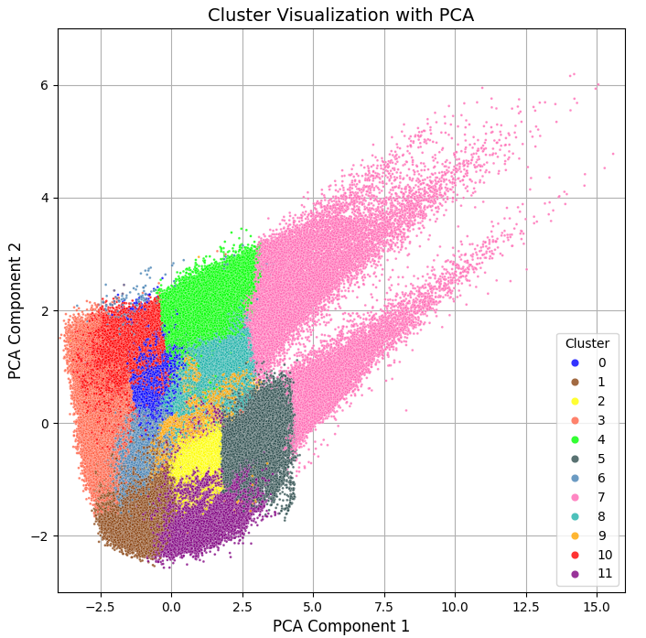
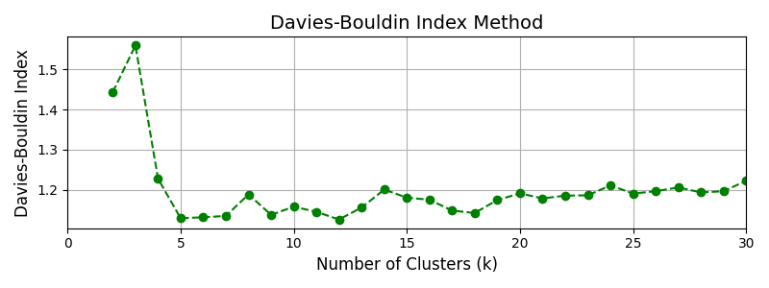
Clustering
K-means with DBI method
The number of clusters was set to 12 by calculating
the Davies Bouldin Index.
Visualization with PCA
To visualize the clusters clearly, we used PCA to
reduce the dimensionality. Two principal components
represent 68.0% of the original data.
minimum point
Contribution rate of PC1 [%] | 45.9
Contribution rate of PC2 [%] | 22.1

Slide 12
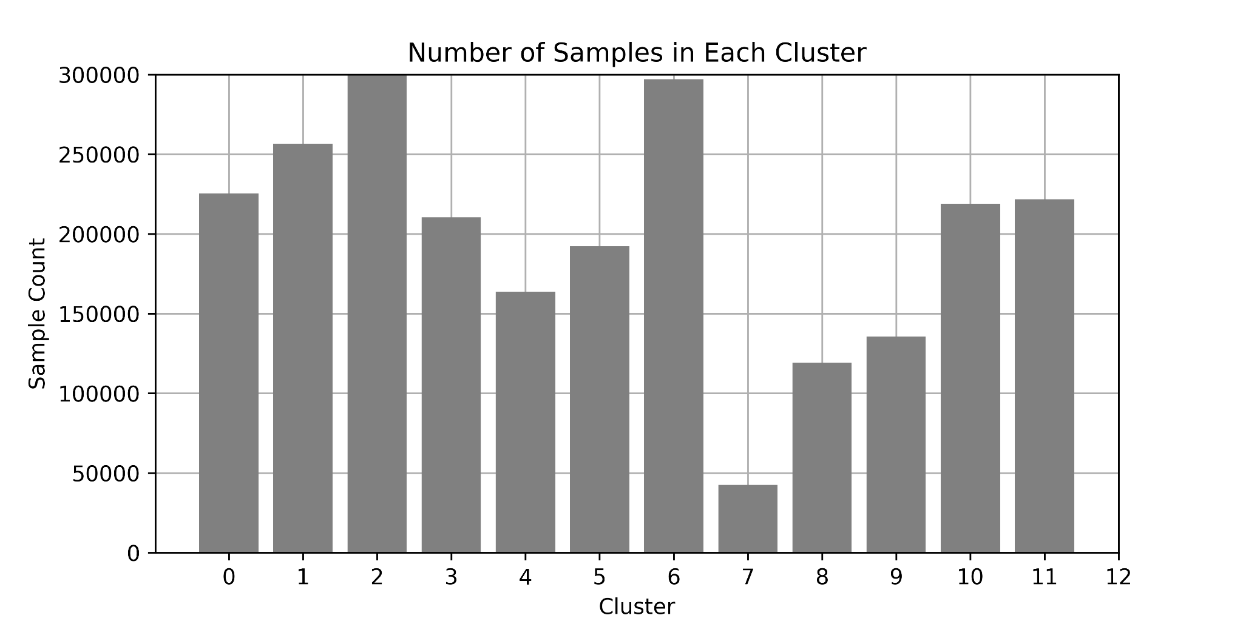
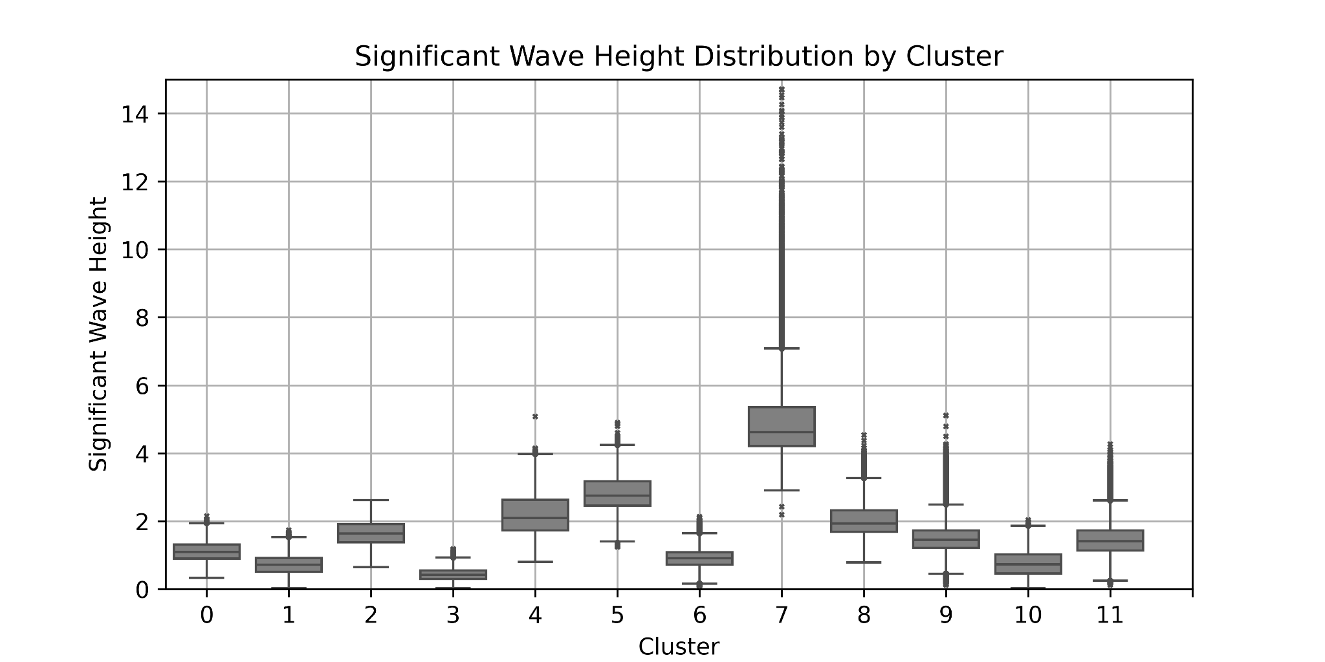
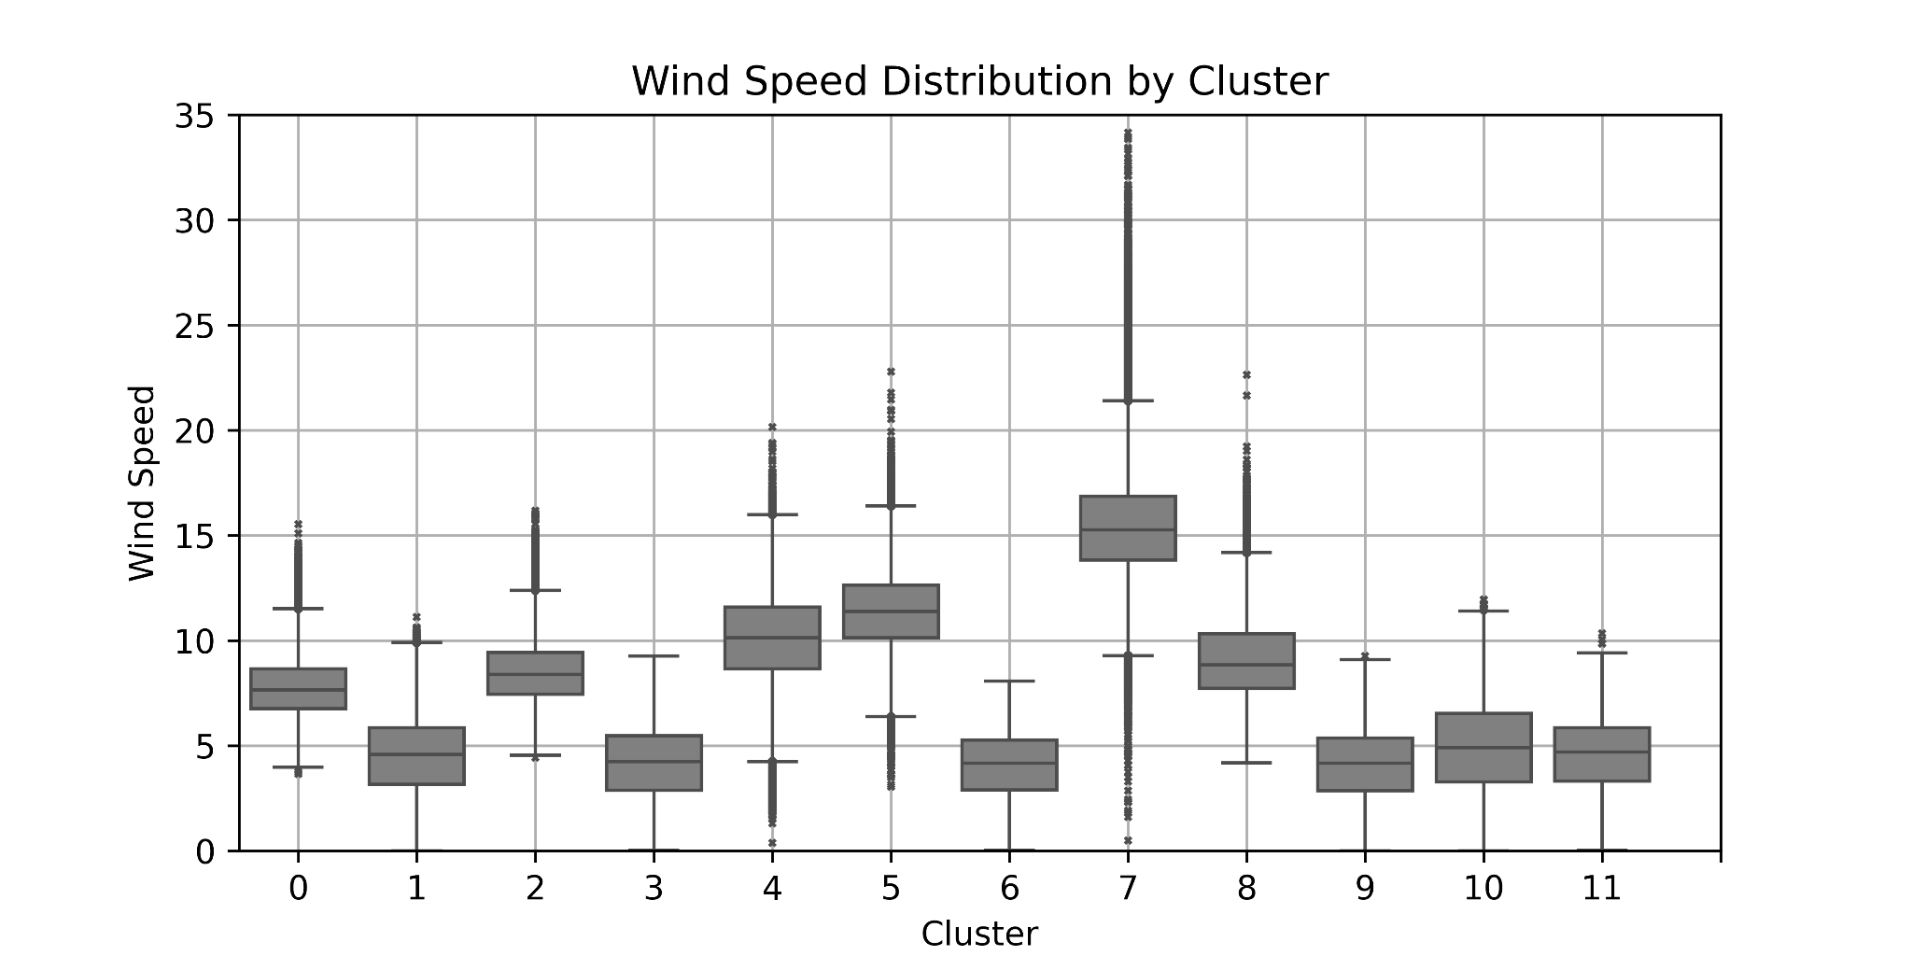
Abnormal sea conditions
Identifying abnormal sea conditions
The wave and wind data within cluster 7
has a large variance and many outliers.
➥ Cluster 7 is considered to be abnormal sea condition
Cluster 7
Notes:
It is difficult to estimate the probability of an accident in the abnormal sea conditions, due to their low occurrence frequency and the low possibility of ship operation.
Therefore, we identified abnormal sea conditions by clustering and labeled separately.

Slide 13
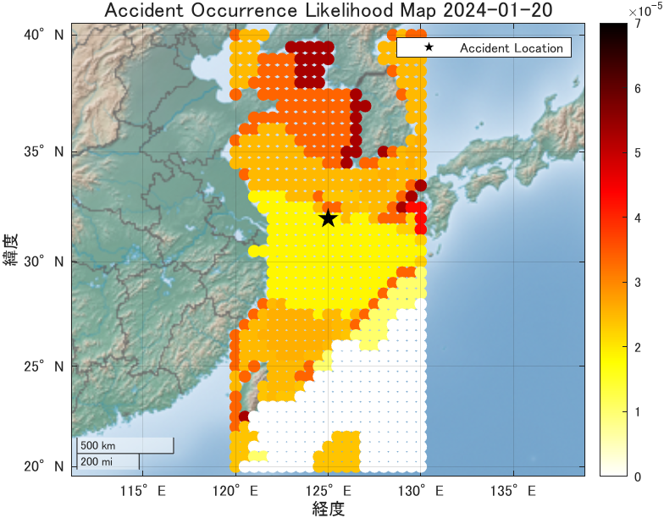
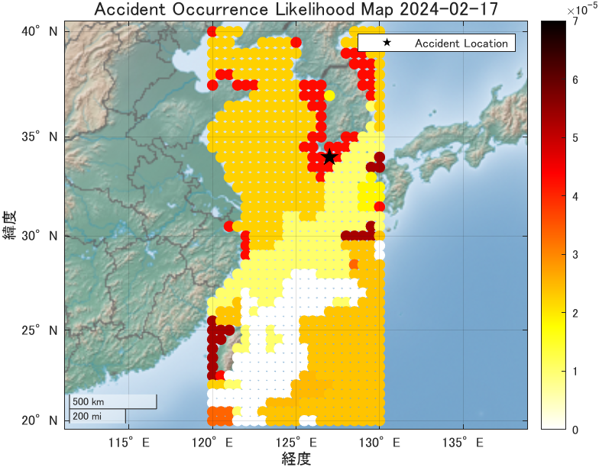
Application to hazard maps
Check the accident case in 2024
Regarding the surrounding sea conditions on the accident occurred day, similar sea conditions were calculated based on clustering over the past nine years, and the likelihood of an accident occurring for each cluster was plotted.

Slide 14
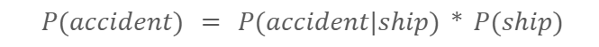
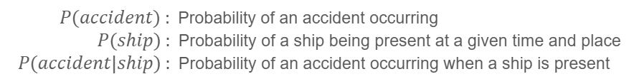
Discussion
We estimated the likelihood of accidents occurring for each sea state by clustering similar sea states. But, this probability estimated this time is thought to hold true as follows.
From the perspective of maritime rescue, visualizing the likelihood of an accident occurring is useful. On the other hand, when considering ship operations, knowing the likelihood of an accident occurring when a ship encounters certain sea conditions is useful.
One future challenge is to use AIS data, etc. to determine the probability of a ship's presence at a certain time and location, and create hazard maps that are useful to ships.
we estimated

Slide 15
Reference
[1] nolativ - flickr, https://commons.wikimedia.org/w/index.php?curid=7337020
[2] 内閣府，”第2編 海上交通 第1章 海難等の動向”，交通安全白書．2022
https://www8.cao.go.jp/koutu/taisaku/r04kou_haku/zenbun/genkyo/h2/h2s1.html
[3] IMO, GISIS(Global Integrated Shipping Information System), Marine Casualties and
Incidents, https://gisis.imo.org/Public/MCIR/Default.aspx, (Accessed on 13-JAN-2025)
[4] Hersbach, H., Bell, B., Berrisford, P., Biavati, G., Horányi, A., Muñoz Sabater, J.,
Nicolas, J., Peubey, C., Radu, R., Rozum, I., Schepers, D., Simmons, A., Soci, C., Dee,
D., Thépaut, J-N. (2023): ERA5 hourly data on single levels from 1940 to present. Copernicus Climate Change Service (C3S) Climate Data Store (CDS), DOI: 10.24381/cds.adbb2d47 (Accessed on 13-JAN-2025)

